Slide 1

Presenter Name:- Suvarna Hebbar USN:- 4VP22MC050
Human Stress Detection Using Machine Learning
Guide Name: Mr. Anil Kumar K Designation : Assistant Professor

Slide 2
Contents
Introduction
Objectives
Literature review
Design Phase
Implementation
Results and Discussion
Conclusion and Future Enhancements
References

Slide 3
Introduction
In the fast-paced and demanding world we live in, the prevalence of stress has become a significant concern for both individuals and society at large. Recognizing the impact of stress on mental and physical well-being, there is a growing need for innovative solutions that can assist in its timely detection and management.
Leveraging the power of machine learning, this project aims to contribute to the realm of human stress detection by developing a robust and efficient system.

Slide 4
Objectives
Develop a Comprehensive Dataset
Feature Extraction and Selection
Model Selection and Development
Real-time Stress Detection
User Interface Integration

Slide 5
Literature Review
Sl.no | Author Name | Title
1 | Panicker | A survey of machine learning techniques in physiology based mental stress detection systems.
2 | Ciabattoni, Lucio and Ferracuti | Real-time mental stress detection based on smartwatch.
3 | Giannakakis | Review on psychological stress detection using biosignals.

Slide 6
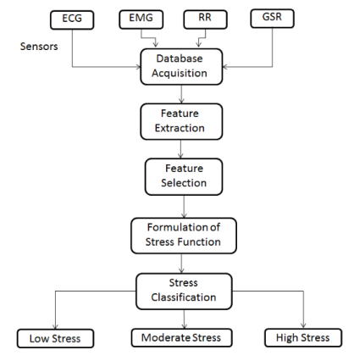
Design Phase
Figure 1:- WorkFlow Diagram

Slide 7
Implementation
Link to Project Demo

Slide 8
Results and Discussion
In this project using a Random Forest Classifier, achieving high accuracy by leveraging features like heart rate variability, Temperature data, and sleep patterns.
The model shows promise for real-world applications in wearable devices for real-time stress monitoring. Future work includes expanding datasets and enhancing model robustness.

Slide 9
Conclusion
A Human Stress Detection using Machine Learning project aims to develop a system that can accurately identify and quantify stress levels in individuals through the analysis of various physiological and behavioral indicators.
The project combines interdisciplinary knowledge from psychology, physiology, and machine learning to create a reliable and effective stress detection system, offering potential applications in healthcare, workplace wellness, and personal well-being.

Slide 10
References
Wijsman, Jacqueline, et al. "Towards mental stress detection using wearable physiological sensors." 2011 Annual International Conference of the IEEE Engineering in Medicine and Biology Society. IEEE, 2011.
Ogorevc, Jaka, et al. "The effect of mental stress on psychophysiological parameters." 2011 ieee international symposium on medical measurements and applications. IEEE, 2011.
Fernandes, Atlee, et al. "Determination of stress using blood pressure and galvanic skin response." 2014 International Conference on Communication and Network Technologies. IEEE, 2014.

Slide 11
Thank you

